Slide 1

Application Layer Protocols
and
Services -3
Delivered By:
Avinash Bhagat
9463281930
avinash.bhagat@lpu.co.in
Copyright © The McGraw-Hill Companies, Inc. Permission required for reproduction or display.

Slide 2
Domain Name System (DNS) Chapter 25
TELNET Chapter 26
Simple Mail Transfer Protocol and Post Office Protocol Chapter 26
File Transfer Protocol Chapter 26
World Wide Web www Chapter27
Hyper text transfer Protocol HTTP Chapter27
Terminologies in Network Security Chapter30
Firewalls Chapter32
Virtual Private Network (VPN) Chapter32

Slide 3
Between1970 to about 1990, the Internet and its predecessors had four main applications:
Remote Logging,
Electronic Mail,
File Transfer
News
Copyright © The McGraw-Hill Companies, Inc. Permission required for reproduction or display.

Slide 4
File Transfer Protocol (FTP)
File Transfer Protocol (FTP) is the standard mechanism provided by TCP/IP for copying a file from one host to another.

Slide 5
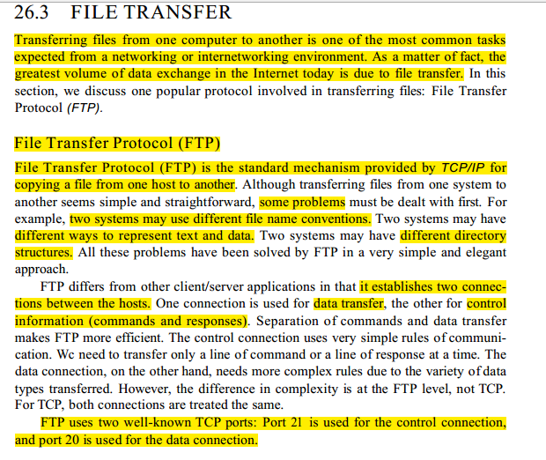

Slide 6
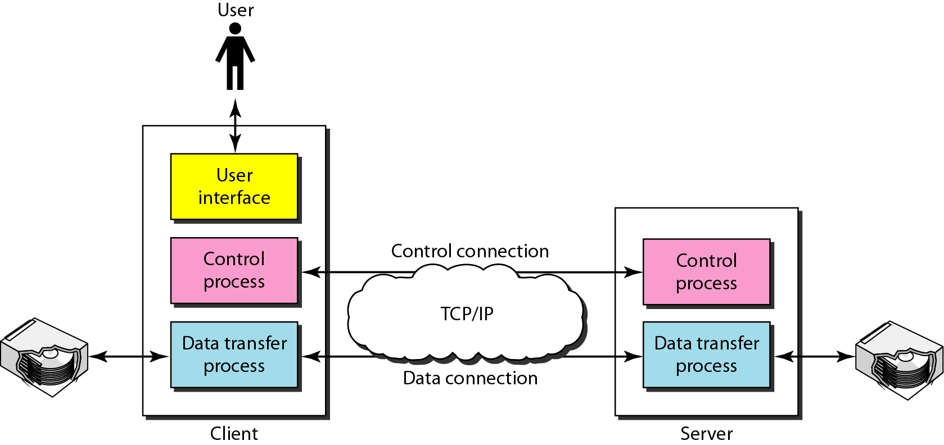
Basic Model of FTP
The client has three components:
        user interface
        client control process
        client data transfer process
The server has two components:
      server control process
      server data transfer process
The control connection is made between the control processes.
The data connection is made between the data transfer processes.

Slide 7
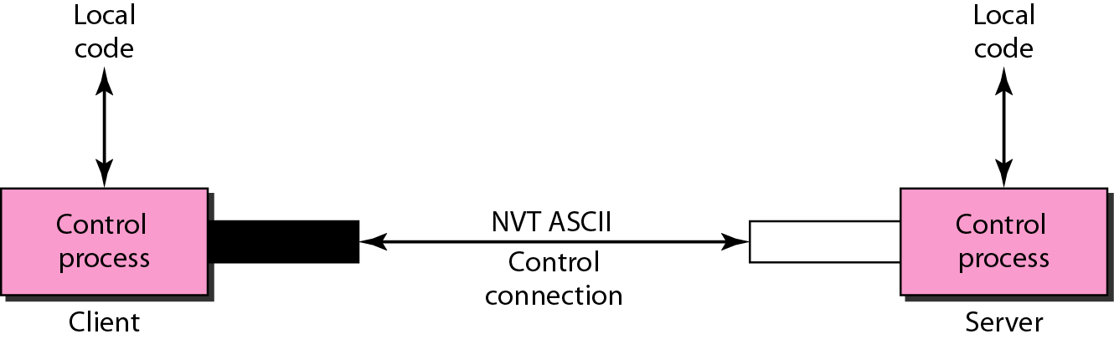
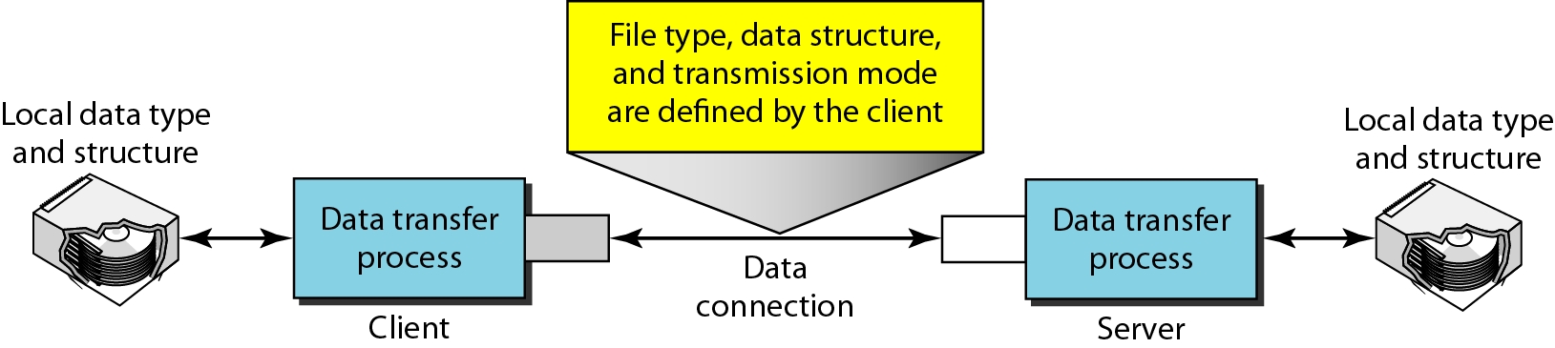
FTP uses the services of TCP. It needs two TCP connections.
The well-known port 21 is used for the control connection
The well-known port 20 is used for the data connection.
Using the control connection
Using the local connection

Slide 8
Subjective
  Explain FTP

Slide 9
Multiple Choice questions
In FTP, the well-known port ____ is used for the control connection and the well-known port ________ for the data connection.
a. 21; 22
b. 21; 20
c. 20; 21
d. none of the above

Slide 10
Multiple Choice questions
In FTP, the well-known port ____ is used for the control connection and the well-known port ________ for the data connection.
a. 21; 22
b. 21; 20
c. 20; 21
d. 22;23

Slide 11
Multiple Choice questions
For the control connection, FTP uses the __________ character set
a. regular ASCII
b. EBCDIC
c. NVT ASCII
d. none of the above

Slide 12
Multiple Choice questions
For the control connection, FTP uses the __________ character set
a. regular ASCII
b. EBCDIC
c. NVT ASCII
d. none of the above

Slide 13
Multiple Choice questions
During an FTP session the control connection is opened _______.
a. exactly once
b. exactly twice
c. as many times as necessary
d. none of the above

Slide 14
Multiple Choice questions
During an FTP session the control connection is opened _______.
a. exactly once
b. exactly twice
c. as many times as necessary
d. none of the above

Slide 15
Multiple Choice questions
During an FTP session the data connection is opened _______.
a. exactly once
b. exactly twice
c. as many times as necessary
d. none of the above

Slide 16
Multiple Choice questions
During an FTP session the data connection is opened _______.
a. exactly once
b. exactly twice
c. as many times as necessary
d. none of the above

